Slide 1
Internship Week 5
Samarth Sharma

Slide 2
ESPRIT theory

Slide 3
Received signal:
A complex vector of N samples
Make subarrays from A of length L
subpacket1
subpacket2
X = N-L+1 subarrays each of length L
subpacket3
subpacket4
Perform Autocorrelation on each subarray. This gives Hermitian matrices of size LxL for each subarray
Take the avg of all these Hermitian matrices. Resultant is the avg autocorrelation matrix of size (LxL): C

Slide 4
Perform QR decomposition on C. Givens Rotation method is used
Init Q=I, R=C -> Iterate through columns of R. For each col j, zero the subdiagonal elements (r_ij, i>j) by multiplying the Given Rotation matrix G(i,j,θ). G(i,j,θ) is a modified identity matrix where the (i,i)th, (i,j)th, (j,i)th and (j,j)th elements are cosθ, -sinθ, sinθ, cosθ respectively, where θ is chosen such that
[ cosθ -sinθ * [a = [r
sinθ cosθ] b] 0], here r = √ (a^2 + b^2), cosθ = a/r and sinθ=-b/r
After rotation update Q and R. Repeat till R is an upper triangular matrix. All rotation matrices are orthogonal by design. G1G2….GnC = R, premultiply appropriately-> C = Gn’Gn-1’......G1’R, where the yellow matrices can be multiplied to obtain Q(an orthogonal matrix). (‘=transpose)
Now the diagonal elements of R are the eigenvalues of C. If we have T targets, the first T eigenvalues arranged in descending order correspond to the signal and others to white noise. These eigenvalues will be large in value as compared to the white noise eigenvalues.

Slide 5
The column vectors of Q correspond to the eigenvectors. Remove the eigenvectors corresponding to the noise from Q to obtain the signal subspace (L x T matrix) S.
Make two copies of S, one removing the last row (A[L-1,T]) and one removing the first row (B[L-1,T])
Split A and B into TxT submatrices (first T rows, 2nd to (T+1)th row, …). We obtain a multiple set of two TxT matrices (Ai, Bi)
Now, we will solve each pair of Ai, Bi for the corresponding φi matrix. [Ai . φi = Bi].
φi = Ai^(-1) Bi. We can alternatively use pseudo-inverse after finding SVD if Ai is not invertible.

Slide 6
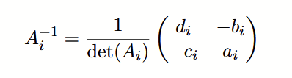
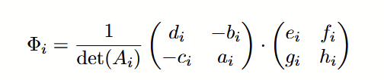
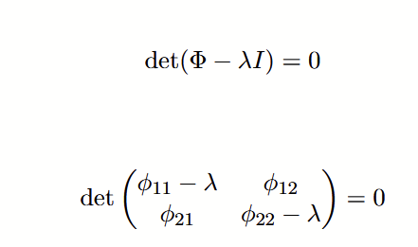

Average all φi matrices. (Φ). Compute eigenvalues of Φ by solving the characteristic equation.
Say T=2.
Let
Characteristic eqn:

Slide 7

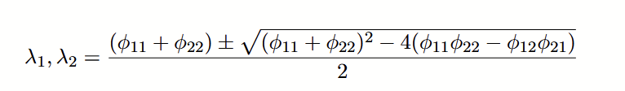
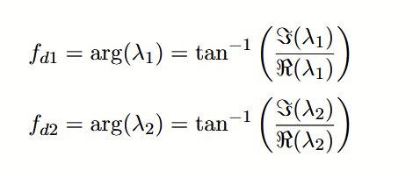
Compute angles of the eigenvalues λ1, λ2. The angles corresponding to the eigenvalues of the ϕ matrix are the estimated Doppler frequency which is then scaled to Doppler velocity

Slide 8


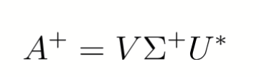
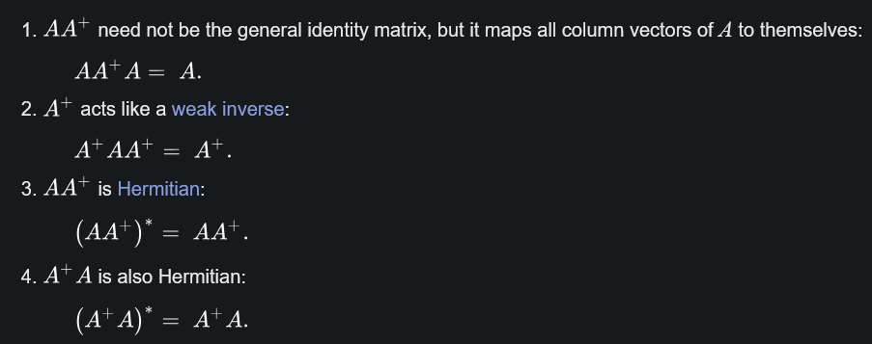
Pseudo-Inverse using SVD
U: mxm complex unitary matrix
Σ : mxn rectangular diagonal matrix
N: nxn complex unitary matrix
Given the singular decomposition of a (mxn) matrix A,
the pseudo-inverse is given by
where Σ⁺ is formed from Σ by taking the reciprocal of all the non-zero elements, leaving all the zeros alone, and making the matrix the right shape: if Σ is an m by n matrix, then Σ⁺ must be an n by m matrix
Properties of pseudo-inverse:

Slide 9
Comparing ESPRIT in SPFL, DPFL with MUSIC in DPFL

Slide 10
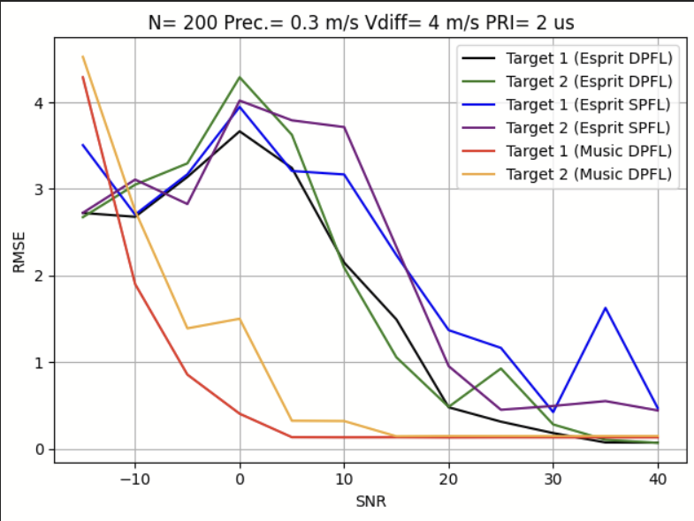
RMSE graph - PS: 200 runs

Slide 11
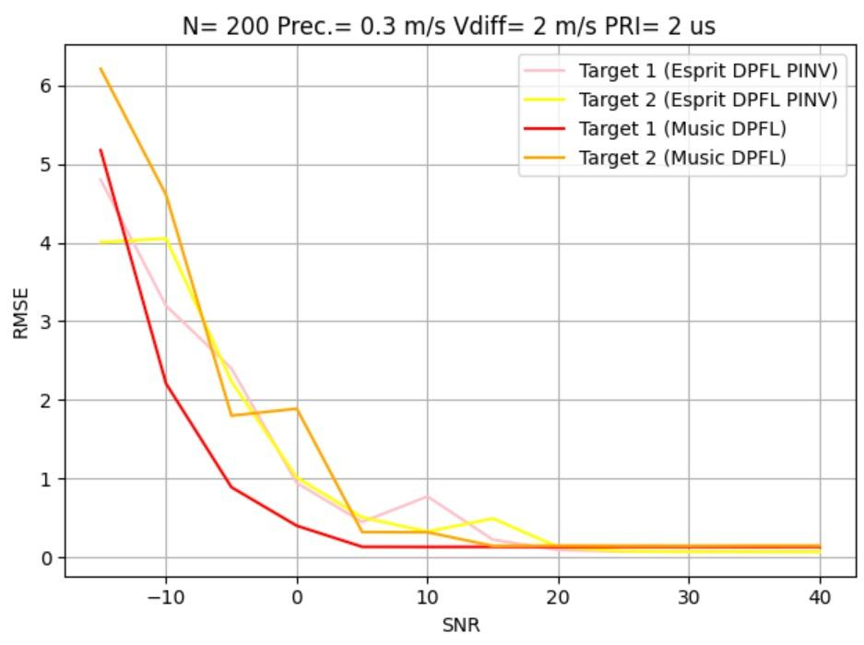
Pseudo inverse implementation of ESPRIT

Slide 12
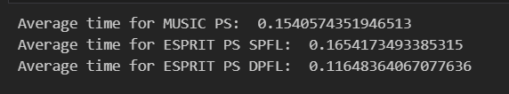
PS times

Slide 13
MUSIC using neural networks

Slide 14
Theory
Auto-covariance approach of MUSIC does not work well when sources are coherent, arrays are miscalibrated or fewer samples are available.
We can use DNNs to map raw input signals to a better surrogate covariance matrix which can be used to replace the autocorrelation matrix.
Input: Autocorrelation over multiple time lags from received signal X.
Rx_tau = [batch_size, tau, 2N, N].
CNN structure:
conv1(tau, 16, kernel_size=2) -> antirectifier (AR) -> conv2(32, 32, 2) -> AR -> conv3(64, 64,2) -> AR -> deconv1(128,32,2) -> AR -> deconv2(64,16,2) -> AR -> dropout(0.2)->deconv3(32, 1, 2)
ReLU activation at each step
Out: Rx = [batch_size, 1, 2N, N] -> reshape to [batch, 2N, N] ->stabilize matrix-> MUSIC

Slide 15
Results

Slide 16
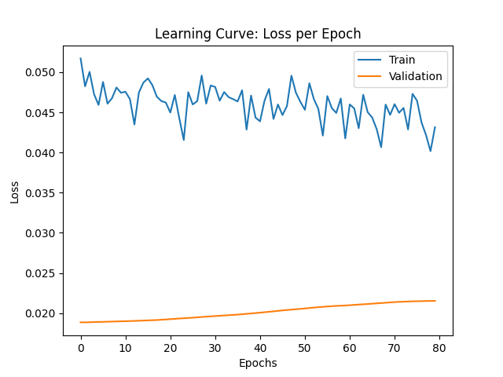
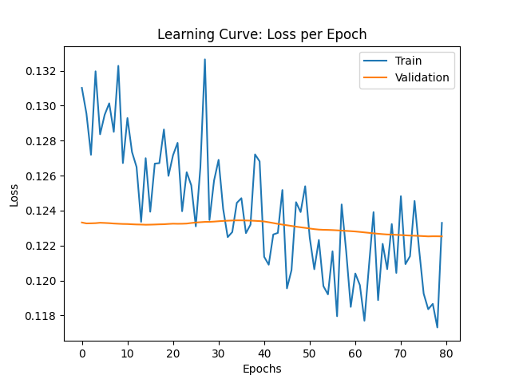
100 samples
Old data
New data created

Slide 17
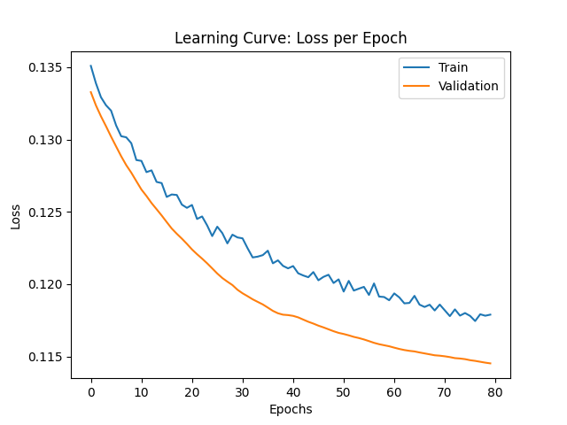
10000 samples

Slide 18
Thank you!!

